Slide 1
NYC Airbnb Data Analysis
Data Source:
https://www.kaggle.com/dgomonov/new-york-city-airbnb-open-data
Data Download
Data Cleaning
Python & Excel
Visualization
Streamlit, Plotly, seaborn etc
Rohan Thekanath

Slide 2
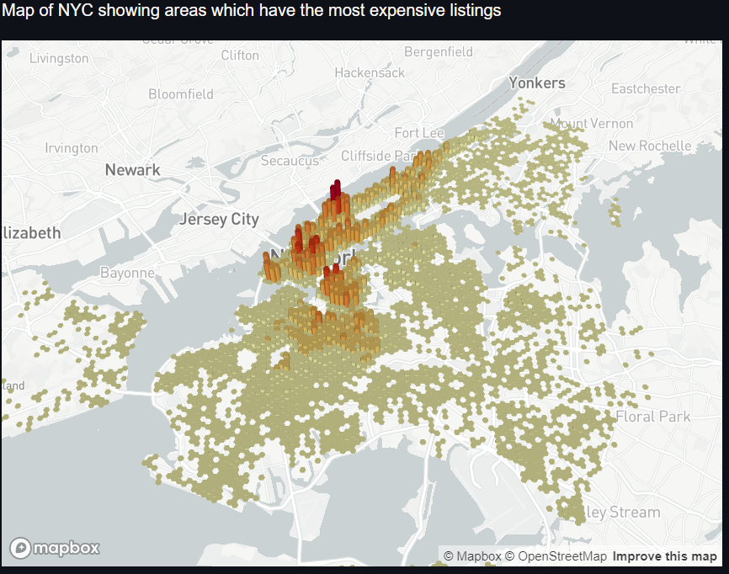
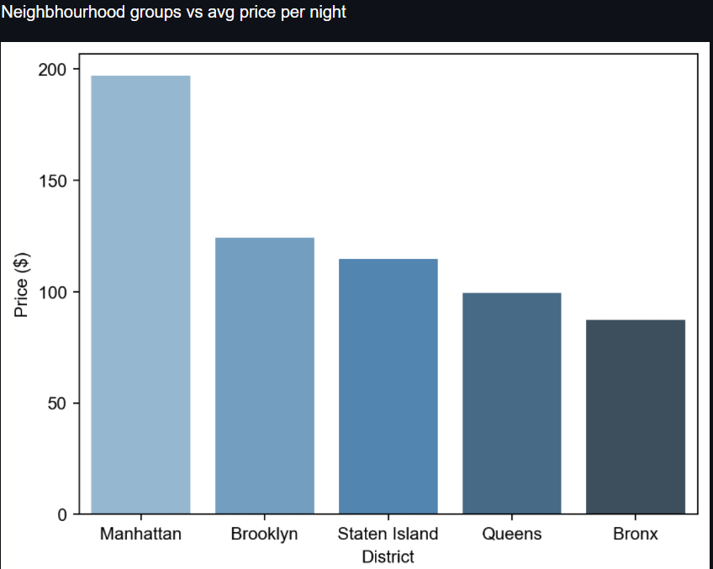
The below two plots make is obvious that the Manhattan has the most costliest listings.

Slide 3
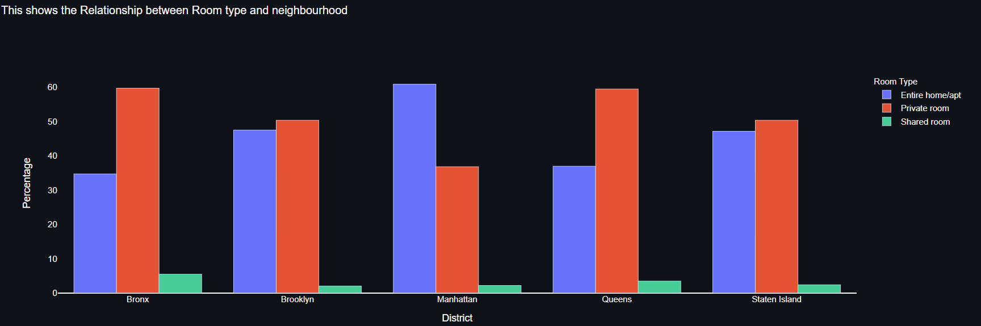
Manhattan has the highest percentage of entire apartments listings.
Bronx & Queens have an equal share of private room listings. They also have the highest share in shared room listings.

Slide 4
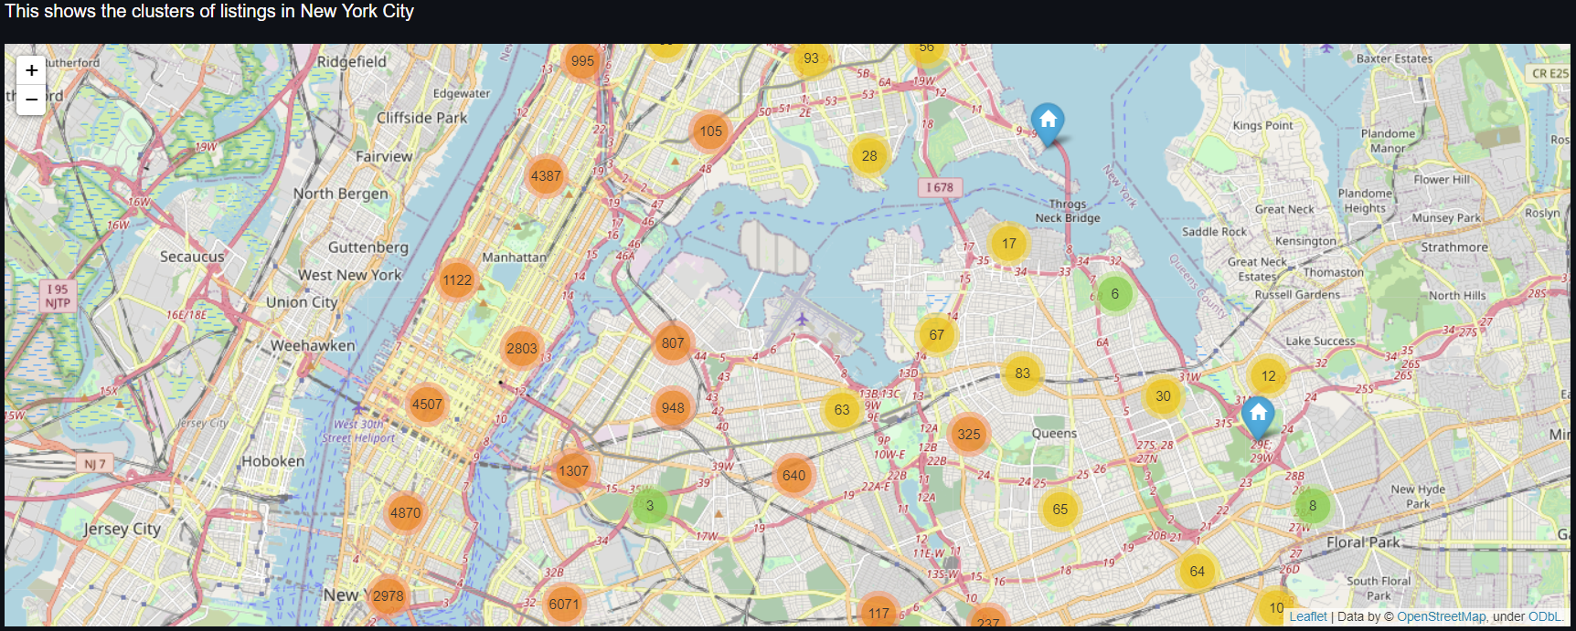
The below map shows clusters of the listings on a map so that it becomes easy to visualize.

Slide 5
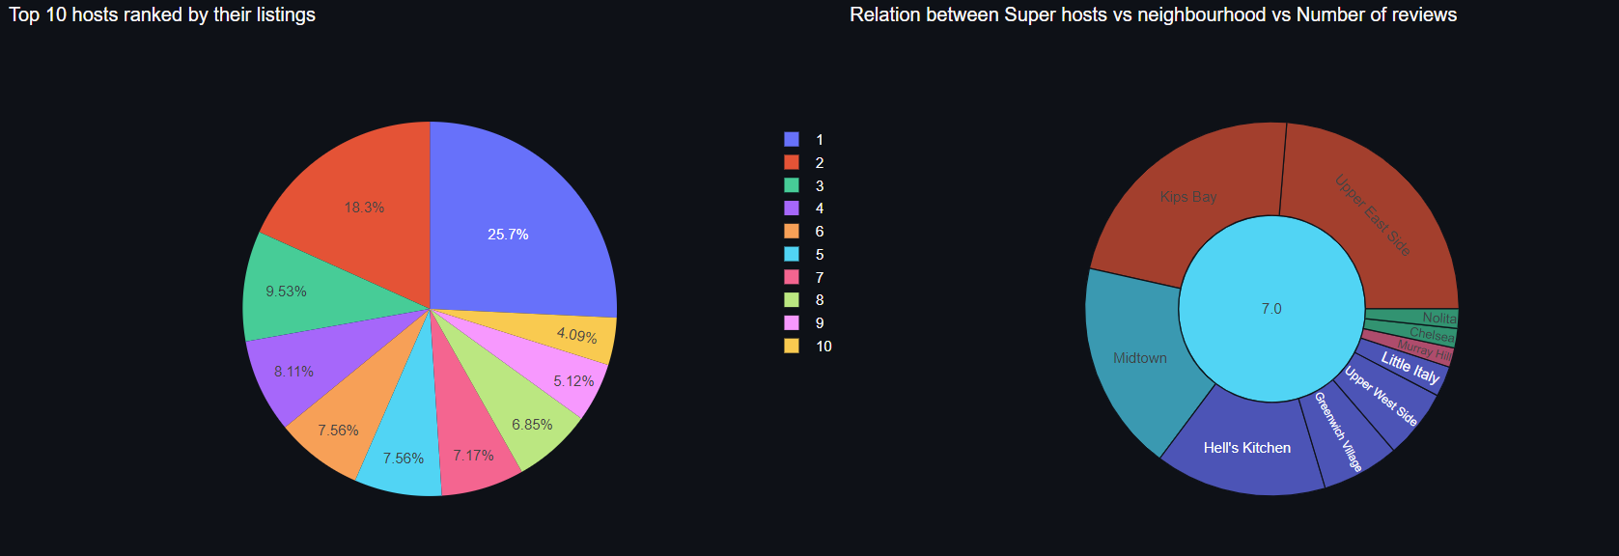
The most famous hosts also know as super hosts are ranked from 1-10 by their total number of listings. Host number 1 has ~25% of the listings.

Slide 6
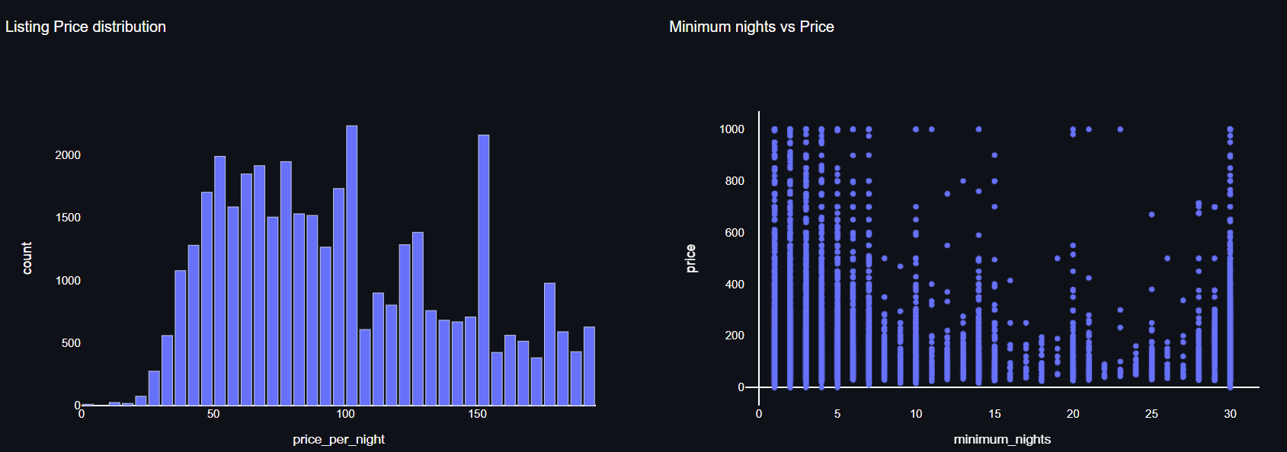
It seems that majority of the listings are priced at $100 or less per night. Listings which are priced at $150 are also common.
It is evident that the price is the highest for renting places which are for <10 days or for a month.

Slide 7
Learning Process:
I got to learn some amazing and latest visualization packages in python and helped me upskill in this space.
I also came across packages like altair and pydeck which helps to process Geo spatial data.
Conclusion:
First, we have found hosts that take good advantage of the Airbnb platform and provide the most listings. We found that our top host has 327 listings.
Neighborhood and neighborhood groups play a crucial role in the price.
Super hosts centralize within three major boroughs, which include Manhattan, Brooklyn, and Queens.
The entire home/ apartment and private room are booked the most in NYC.
We learn that there are a lot of listings in Manhattan, the price range can really vary too! We also found a feeling of what the market value of the rent for apartment + shared room.

